Slide 1
Title I – Parent Engagement Training
HLI for Parents and Families
2022-2023
Notes:
This presentation is designed to help explain HLI or Healthy learning initiative to parents.

Slide 2
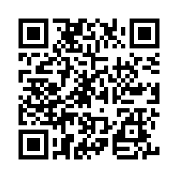
Please Take the Pre-Training Survey

Slide 3
How to Explain HLI to a Parent
Explain what HLI is
Healthy Learning Initiative – how schools teach students to be self-aware and develop self-control, interpersonal skills, and coping skills that help with challenges big or small
SEL is an education approach that emphasizes direct instruction of skills like how to resolve conflicts and understand differing points of view, changing school policies to be more developmentally sensitive, and working with family and community partners to meet students’ non-academic needs.
Explain the Benefits
Students with HLI skills:
Good attendance
Deal with life stresses in stride
Academic grade increases
Enhanced self-efficacy
Increased confidence
Positive behavior in class and at home

Slide 4
Why a Parent may be concerned about HLI
Not enough information or lack of specific information
Lots of media coverage
Believed to open up talks of scary topics
Considered a passing fad
Hits ideological bias
Thought that parents’ job not schools to help children develop self-control and relationship skills
Their child might teach them a skill or display a learned skill that parents do not have or were not taught – makes them uncomfortable and feel like less of an authority

Slide 5
How to Combat Parent Concerns
Promote confidence in school board decisions to not create divisive learning environments
Explain positive benefits for future and career
Provide examples from your classroom
Explain why/how HLI was created – In 1994, scholars from multiple fields—such as emotional intelligence, child development, prevention science, bullying prevention, and public health identified key skills and competencies students need to successfully navigate school and life.
Provide strategies for at home use
Make an individualized learning plan for the student and family
Send home worksheets for parents and students to complete together
Send home information
Be open with parents about child’s behavior

Slide 6
How a Parent Can Support HLI
Be a good listener and build listening skills in yourself and your child
Model the behavior you seek – children learn behavior from parents – golden rule reaches all facets of life
Nurture your child's self-esteem – give responsibilities, allow child to make decisions, show appreciation
Respect differences – we are all good at different things – don’t compare your child to others or siblings
Take advantage of support service – advocate for your child and communicate with their teacher
Investigate your school's efforts to support emotional learning – talk to staff and attend SAC
Get involved – volunteer at the school and learn as you go
Provide opportunities to talk about HLI
- Edutopia

Slide 7
Can Parents Learn HLI?
Yes! There is always time to learn!!!!!!
Be reflective
Read Up
Learn to manage stress
Read what the school/teacher sends home
Talk or think things through
Emote and talk about feelings
Ask questions
Five Competencies of HLI:
Self-Awareness
Self-Management
Social Awareness
Relationship Skills
Responsible Decision-making
Notes:
Some people say that they like to learn the hard way. That’s totally me. I have personally benefitted from learning HLI and wish these skills were taught when I was in school. Would have helped me have a good relationship with siblings and make less risky and stupid choices as a teen and young adult.

Slide 8
HLI Resources for at Home Learning
Websites:
Casel.org – explains HLI in length and provides implementation strategies
https://quandarygame.org/
https://pbskids.org/games/feelings
Additional resources in Classlink
Games:
Don’t Break the Ice – write questions on blocks
Happy or Not
Emotion Flashcards
Silly Street
Essential Conversation Cards
Stop the Drama Thumball
Mindfulness Matters
Chat Chains
I Like Me 1 2 3
- All available on Amazon

Slide 9
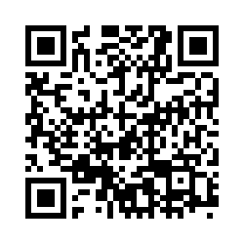
Please Take the Post Training Survey

Slide 10
Thank you
Elizabeth Hogan
305-293-1400 53370
Elizabeth.Hogan@keysschools.com

