Slide 2
Eight Components of School Health
The eight components of the CSH model, when looked at in a coordinated manner, have been shown to be highly effective in facilitating the creation of policies and environments that provide students and staff the opportunity to reach their personal potential by removing health related barriers to academic success.
Health Education
Physical Education
Health Services
Nutrition Services
Counseling, Psychological, and Social Services
Healthy School Environment
Health Promotion for Staff
Parent and Community Involvement

Slide 3
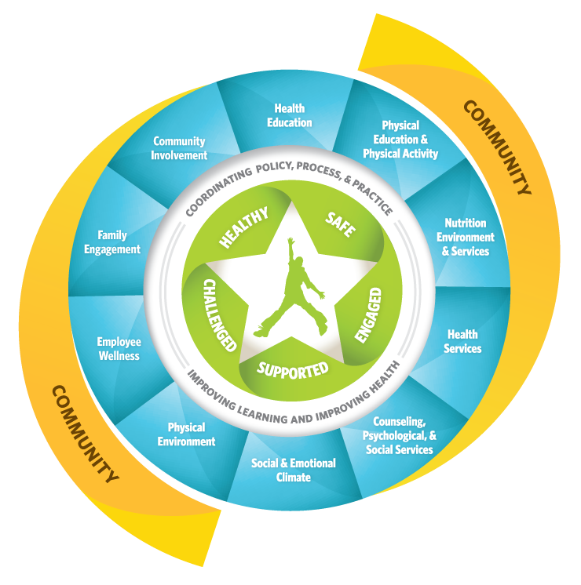
The Whole School, Whole Community, Whole Child (WSCC) model
expands on the eight elements(http://www.cdc.gov/healthyschools/wscc/approach.htm) of CDC’s coordinated school health CSH(http://www.cdc.gov/healthyschools/wscc/approach.htm) ) approach and is combined with the whole child framework.
CDC and ASCD developed this expanded version—to strengthen a unified and collaborative approach designed to improve learning and health in our nation’s schools.

Slide 4
Experts in the eight components of CSH focus primarily on six risk behaviors that have been identified to be most detrimental to youth:
inadequate physical activity
poor nutrition
tobacco use
alcohol and other drugs
intentional and unintentional injury
risky sexual behavior

Slide 5
Florida Healthy School Districts
The application period for the Florida Healthy School District Award opens in January of each year. Applications are due by April 15 at close of business. The Self-Assessment and instructions are available at http://safehealthyschoolsfl.org/Home.aspx/Index.

Slide 6
Online CSH Training
Online training course offers quizzes and printable certificates for each training topic that is successfully completed.
Each section is self-contained so that you may complete the training topics independent of each other.
To complete all 4 sections will take approximately 1.5 – 3 hours depending on the user’s level of understanding.
http://www.healthydistrict.com/

Slide 7
F r e e g r a n t w r i t i n g a s s i s t anc e
Does the idea of writing a grant make you tremble in fear? Do you think you don’t have the skills to do it? United Healthcare Foundation provides free resources for grant writing that help schools, parents, districts and community partners who are, or are considering writing grants. The resources are useful whether you’re writing a small or large grant; are a novice or seasoned grant writer.
Click on the link below to sign up for training and other resources to help you locate and write for funding for your initiatives. https://www.uhccommunityplan.com/uhc-grants.html?utm_source=UHC&utm_medium=print&utm_campaign=community_grant There’s also a free grant guide that comes out every month and it includes tons of grants from lots of organizations.
Grant writing training and resources
Monthly Grant Guide features dozens of new federal and foundation grants on high priority health issues.
Webinars to help you interpret funders’ top questions, the core elements of a strong proposal, and ideas on successful program design. Webinars are held on the second Wednesday of every month from 12:00 to 1:00 Eastern Standard time.
For more information contact Diane Owens at diane_r_owens@uhc.com.

