Slide 1
Survey Results Comparison
Title I
2021-2022

Slide 2
Total Parent Responses
Beginning of Year Survey Responses: 159
Survey link provided online through Qualtrics
Paper survey sent home
End of Year Survey Responses: 86
Survey link provided online through Panorama
Paper survey sent home

Slide 3
Do you feel welcome when you enter the school?

Slide 4
I have been encouraged to volunteer at school.

Slide 5
I feel knowledgeable about the school’s expectations for my child.

Slide 6
I feel knowledgeable about what is going on at the school.

Slide 7
I feel that parents are involved in decision-making at our school.

Slide 8
I feel knowledgeable about the Title I program.

Slide 9
My child receives additional academic help when needed.

Slide 10
My child’s educational and behavioral progress is shared with me regularly.

Slide 11
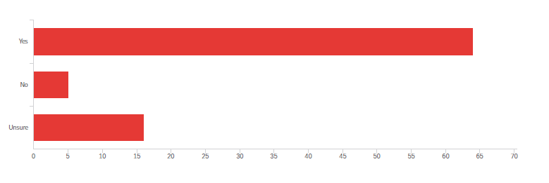
The school provides our family with parenting resources and a parent resource center.

Slide 12
Teachers regularly communicate with me.

Slide 13
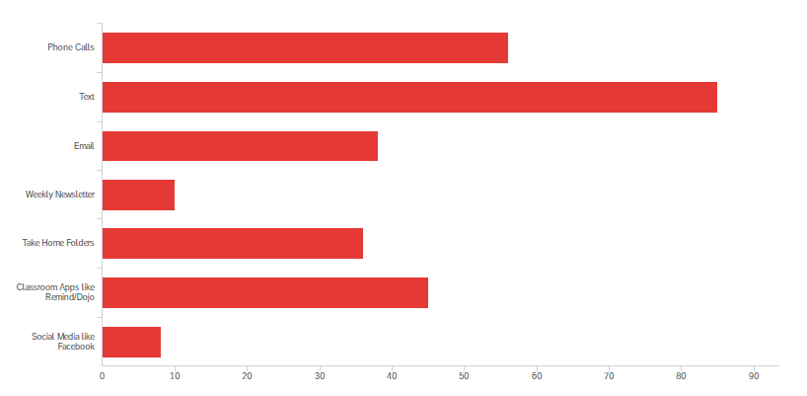
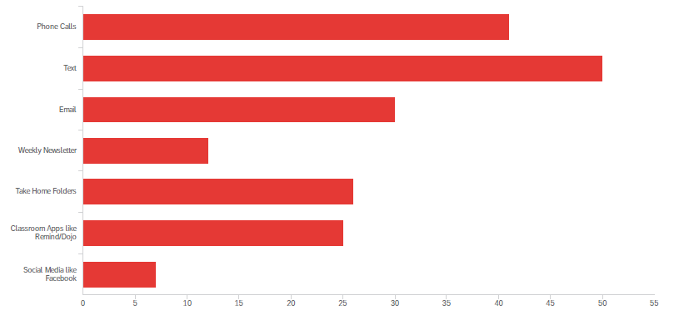
I prefer teacher communication to be:

Slide 14
The school schedules parent/teacher conferences so that I can attend.

Slide 15
I have received a copy of or a link to the school level Parent and Family Engagement Plan (PFEP).

Slide 16
I have been invited to participate in school planning such as the school improvement plan, the Title I plan, parent involvement policy, etc.

Slide 17
I have received or signed a compact – the agreement between Teachers, Parents, and Students.

Slide 18
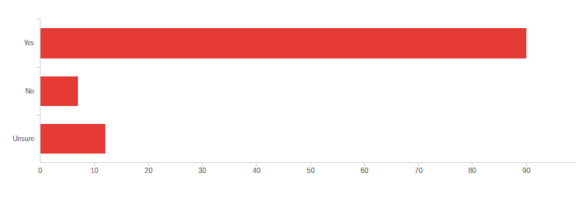
The School-Parent Compact provides a meaningful way to communicate with my child’s teacher.

Slide 19
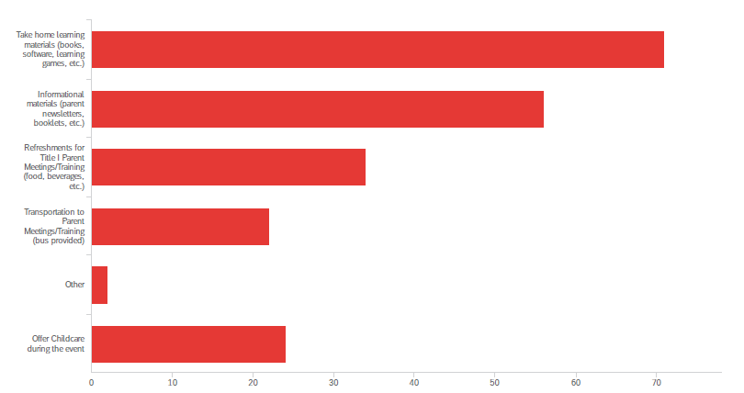
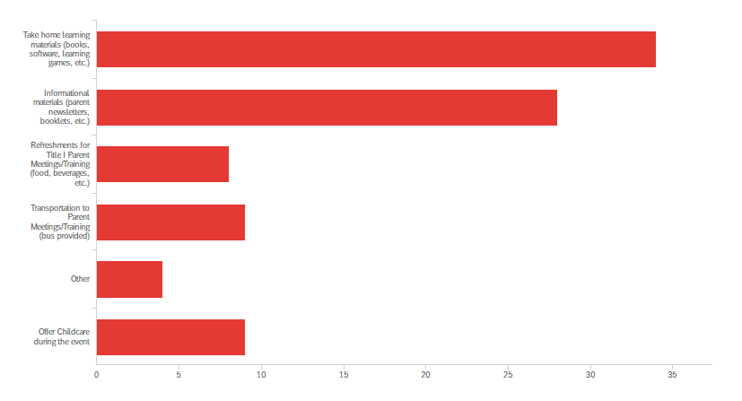
At least 1% of the district’s Title I allocation is dedicated to parental engagement activities.

Slide 20
Which time of day would be best for you to attend school meetings?

Slide 21
What prevents you from attending Parental Involvement events and how can we make it possible for you to attend?
Most Common Responses
Work
Childcare
Language
Schedule Conflicts
Caregiver to adult family member
Didn’t Know/Not enough Notice
More Notice
Offer Multiple Times
Provide Interpreter
Offer Virtual Events
Outlier Responses
Zoom meetings would be helpful
Call me a day before
Text before
Configure the website better. Regular updates. Combine information in one service like Dojo app but without monthly payments.
You can makes a vote to choose a suitable hour.
Earlier notice of classroom events. I was notified the Sunday before the Wednesday event. My work schedule is made 3 weeks in advance!

