Slide 1
State of the hurricanes
Coral shores high school 2017-2018
Quarter 1

Slide 2
random acts of kindness
Irina Gonzalez
Kadrian Williams
Zack Canton
Jessica Almonor
Misty Owens
Miranda Piekarski
Shennan Kasprzak
Patryk Peitruch
AJ Leffler
Ralph Howell
Katie Robinson
Jake Curry
Connor Rhyne
Melissa Diaz-Duran
Shannon McCormick
See Ms. Jaime in Office

Slide 3
Congratulations Destiny Ruiz mcsd Gem Award for her work in achieve!

Slide 4
Perfect attendance award
Taylor Albury
Oliver Allison
Tara Amador
Jonathan Babich
Andrea Beckman
Olivia Betancourt
Elijah Blanco
Callie Bloom
Katharina Borders
Alvin Brown
Brayan Calatayud
Perry Carlson
Lillie Carter
Madeline Chilton
Dallas Christmas
Timothy Cole
Matthew Conley
Javier Correa
Matthew Darrow
Cayleigh Deakins
Hunter Dixon
Elizabeth Dobson
Clark Drebenstedt
Sarah Duffy
Yoendry Ferro
Lily Firkins
Joseph Forcine
Rebecca Galvan
Ava Garcia
Rachel Machado
Kevin Markevitch
Benitez Martinez-Benitez
Zareska Mazola Ortega
Daniel McMahon
Kegan Morris
Dylan Nason
Bethany Norling
Ovel Ocana
Angel Gutierrez
Javier Hernandez
Luma Gibus
Wellington Gideon
Garret Gilbert
Sheila Gonzalez
Adam Gordon
Jonah Gross
Ryan Guth
Yansey Hernandez-Vega
Elise Jordan
Jason Kaczka
Michela Kidd
Daniel Koerperich
Hannah Lane
Skylynn Lindback
Cora Long
Norving Olivas
John Owens
Hailey Pacyna
Vanessa Pelaez
Patryk Pietruch
Bryan Placencia
Kaitlin Pooley
Shelby Porter
Julie Powers
Jesse Rego
Erin Rodberg
Thomas Rodberg
Lucia Rodriguez
Olivia Conwell Rodriguez
Alondra Alejandra Rodriguez-Diaz
Paul Ross
Gabriel Rubiales
Emme Santayana
Jennifer Setchell
Samantha Simon
Spencer Simon
Colton Snodgrass
Draven Tucker
Cheyenne Veloso
Dillon Walters
Zachary Webb
Jonathan Williams
Alison Woltanski
George Yeatman
Caitlin Yong
Abigail Zischka

Slide 5
Ms. Andersen
Mrs. Andersen's Math Rockstars
Period 1
Zakarie Filpes
Zareska Mazola Ortega
Lillia Adrian
Frank Perlik
Period 4
Erik Eriksen
Irina Gonzalez
Vaclav Cernosek
Phoenix Hardin
Period 7
Lorena Carballo
Isaias Molina
Angel Martin Santos
Amber Stevens
Period 5
Jennifer Duque-Diaz
Carlos Magdaong
Kevin Leon-Gonzalez
Period 3
Andrea Galvan
Ashley Hilson
Donovan Hassen
Marc Petrusha

Slide 6
Mr. Bosque
3rd Period – Jackson Hilson, Hunter Wunderlich
4th Period – Orlando Ortega
5th Period – Nick Norman, Roberto Rivera
7th Period – Colin Campbell, Liyiccia Torres

Slide 7
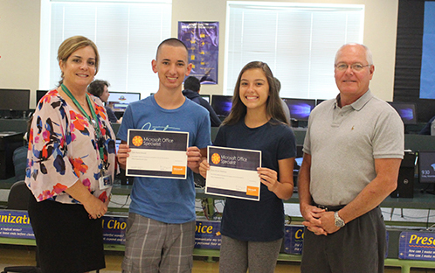
MS. BRITTON
Digital Info Tech
Tyler Arnold, Keiffer Kemmer, Grace Mathews
Custom Promotional Layout & Design
Jared Pastuck, Patryk Pietruch
AP Computer Science Principles
Period 4 Austin Fernandez, Lauren Hack, Jorgen Heilbron, Jonathan Williams
Period 5 Tim Cole, Matthew Darrow, Leo Snell, Alejandro Tovar-Morales,
Period 6 Lily Costa, Tim Orr, Alexis Romero
Website
Lillie Carter (photographer), Miguel Quezada, Sophie Williams

Slide 8
Mr. catlett
Marine 1:
Tony Thiele & Nick Norman
Marine 2:
Dominic Austin & Matt Hardison
Marine 3:
Orlando Ortega & Craig Beattie
Marine 4:
Hyatt Spaulding & Cody Guy
Building Construction:
Yansey Leduar Hernandez & Yoendry Ferro

Slide 9
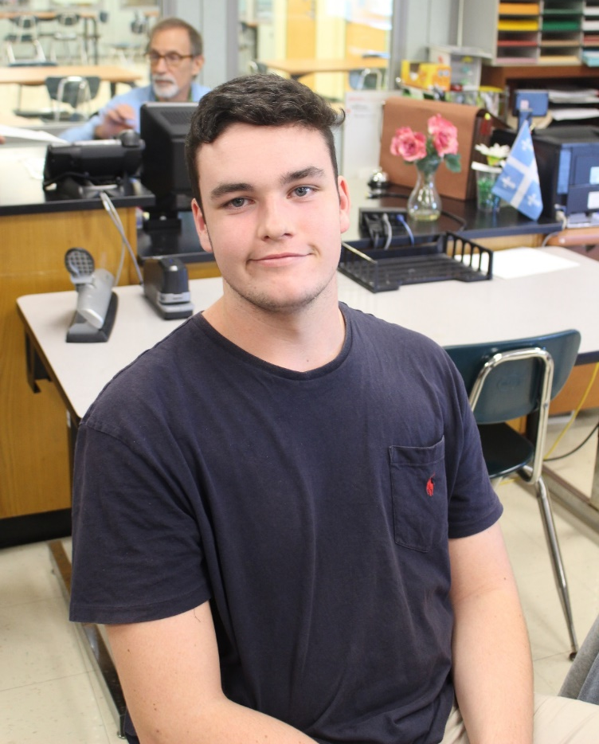
Ms. Dehart
Period 2 – U.S. History:
Jade Hanson
Kyle Kraus
Period 5 – U.S. History:
Amber Wiggle
Juan Pablo Orjuela
Period 6 – U.S. History:
Courtney Conley
Rosa Rodas
Period 3 – AP Psych:
Kendra Powers
Anna Carucci
Molly Gahagen
Period 4 – AP Psych:
Zane Turbessi
Tim Orr

Slide 10
Ms. Dobson
Freshman AVID All-Stars:
Alvin Brown, Ashley Hilson, Noemi Quezada, Donovan Poe, Christy Owens, Abigail Sebben, Vanessa Pelaez, Lorena Carballo, Yoendry Ferro, Katie Figueroa, and Alex Gutierrez
Highest GPA in AVID:
AVID I: Kaylee McDaniels
AVID 2: Simon Orjuela
AVID 3: Amber Wigle
AVID 4: Brandon Rowland
Dobson’s English I Honors
Outstanding English Student:
Emma Kost

Slide 11
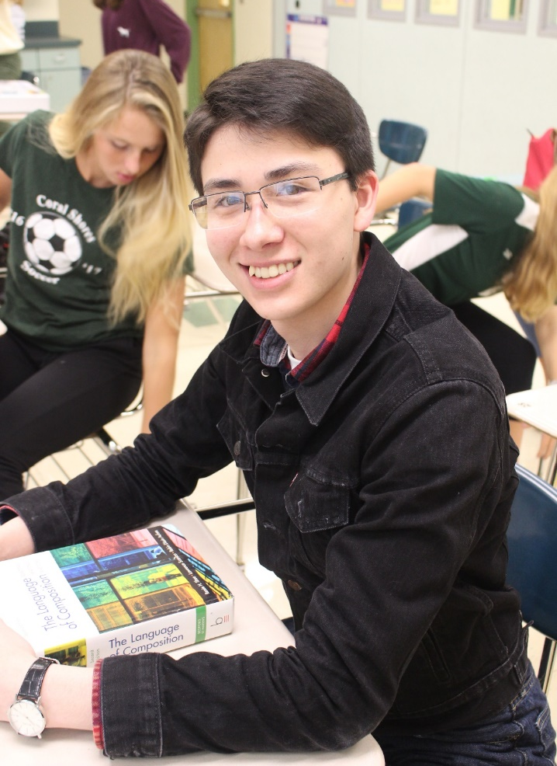
Ms. Mj fry
U.S. Government:
Juan Fleita
Colt McGee
Parker Schildts
Melannie Rodas-Guevara
U.S. History:
Rachel Medina
Tim Cole
Jonathan Babich

Slide 12
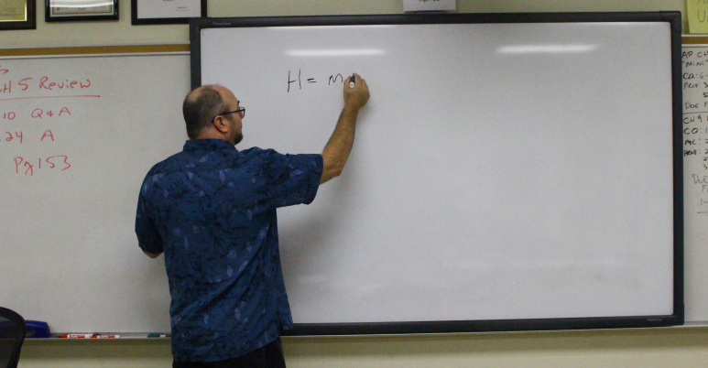
Mr. Gideon:
Earth & Space Science:
Amber Stevens
Jason Kaczka
Hunter Dixon
Katie Figueroa
AP Physics:
Julia Prieto
Physics 1:
Emma Marsden

Slide 13
Ms. Hager
Students of the Quarter:
Alyssa Webb
Allie Adler
Katy Borders
Katelyn Gemonprez
Grace Matthews
Brandon Turner

Slide 14
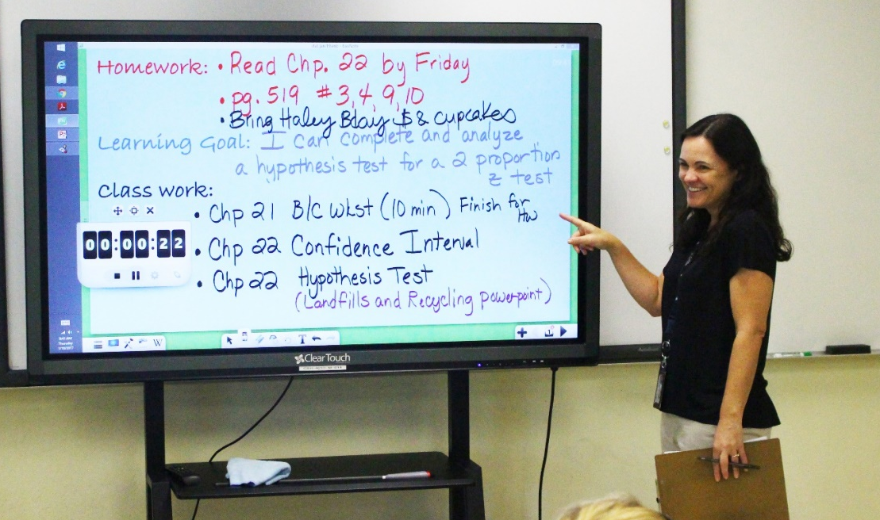
Ms. hamilton
AP Statistics:
Kendra Powers & Halley Lane
Honors Geometry:
Alexis Martin, Marie Perto, & Dominic DiMaggio
Geometry:
Jennifer Setchell

Slide 15
Ms. HAMILTON (P.E.)
Students of the Quarter:
Avery Caceres
Paul Ross
Amber Stevens
Tatiana Ayala

Slide 16
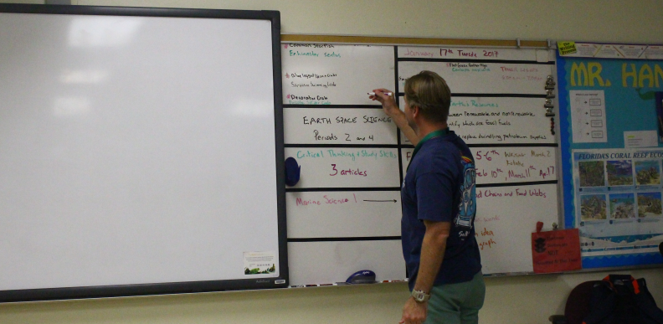
Mr. hane
Quarter 1 Outstanding Students:
3rd Period – Reading: Brian Mora, Teressa Kent
4th Period – Reading: Jordan Whitehead, Cameron Carter
5th Period – Integrated Science: Jayson Turner, Ryan Guth, Skye Alwardt
6th Period – Integrated Science: Megan Buck, Krysten Starr, Leesa Ross
7th Period – World History: Lina Coole, Yanisleidy Machado, Dillon Walters

Slide 17
Mr. Hurst
2nd Period
Leroy Dawson, Bryan Valdes, Amore Mowery, Ariel Chavez
3rd Period
Amanda Batista, Lorenzo Scott, Albert Rodas, Rose Rodas
7th Period
Justin Gilmore, Josue Garnez, Angel Guitierrez,
Angie Axume, Christy Owens, Ricardo Placencia

Slide 18
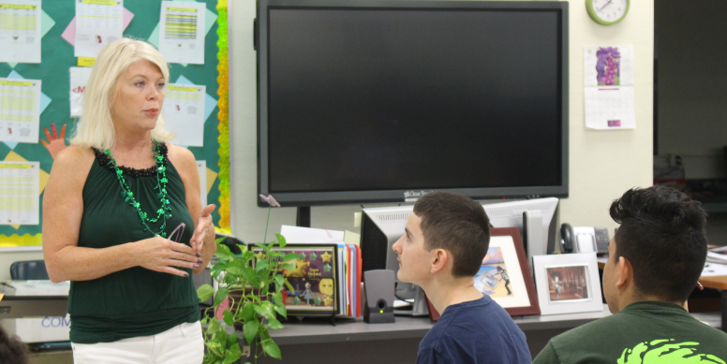
Ms. Joy
Students of the Quarter:
Destiny Ruiz
Taylore Kent

Slide 19
Ms. Kater
Social Studies Superstars!
Government
Pd. 1 – Mackenzie Freeman, Jake Curry
Pd. 2 – Samantha Demeritt, Dylan Hussey
Geography
Pd. 4 – Skylar Poisson-Zettwoch, Dallas Hutchison, Abby Zischka
Pd. 5 – Brent Johnson, Donovan Poe
Pd. 6 – Emma Abel, Clayton Conley
Pd. 7 – Quinn Johnson, Bethany Norling

Slide 20
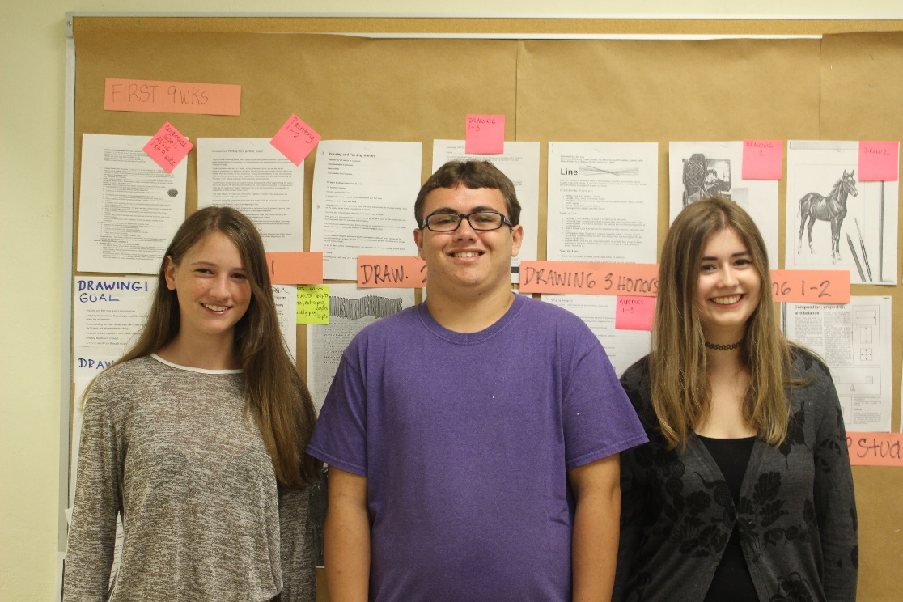
Ms. kelley
Drawing 1-3, Honors
Sarah Duffy 9
Sofie Kubida 10
William Mutz 11
Kendra Powers 12
Brooke Peacock 12
Ceramics 1-3 Honors
Brittany Beyers 12
Dustin Chamberlain 12
Angel Santos 9
AP Art
Juliane Jankowski 12
Leesa Ross 12
Berkeley Wolgamott 11
Painting 1-3
Michela Kidd 9
Mc Kenzie Emrich 11

Slide 21
Ms. Knudsen
Students of the Quarter:
Katelyn McCollum
Josh Prince

Slide 22
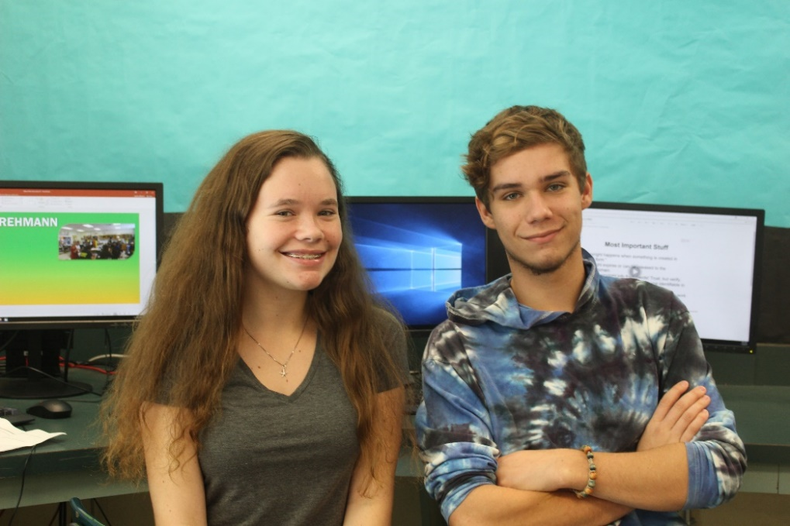
Ms. ledoux
APES: Sophie Williams
Biology Honors: Ali Woltanski

Slide 23
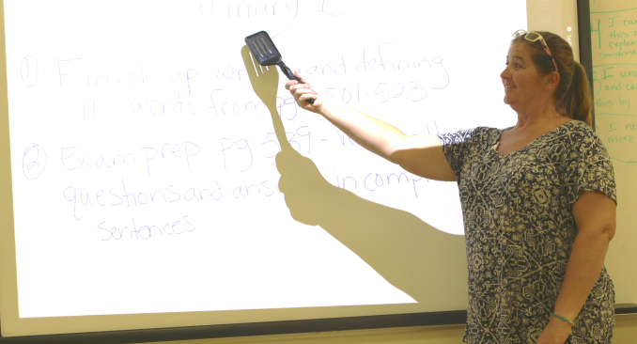
Ms. mcgraw
Students of the Quarter:
Susan Gutierrez
Marie Perto
Hailey Pacyna
Dylan Nason
Abigail Zischka

Slide 24
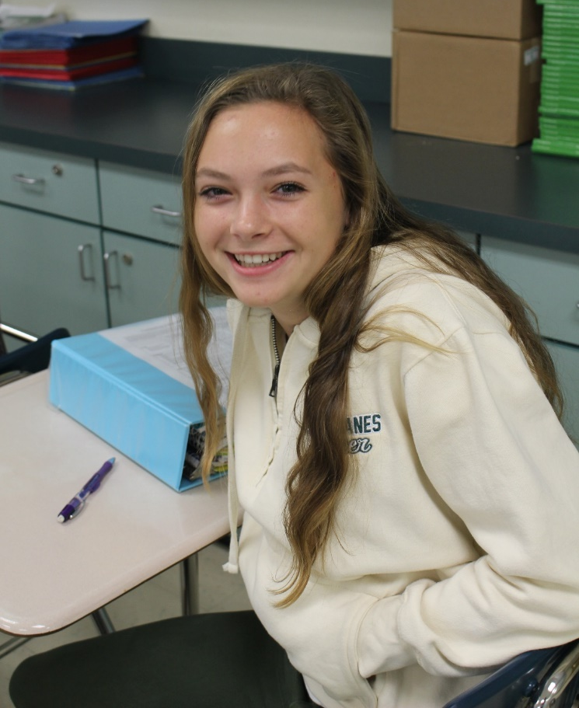
Ms. O’connor
English II Student of the Quarter:
Imani Murphy
Isabella Contreras
Susan Guitierrez
Dean Wolgamott
English II Honors Student of the Quarter:
Maggie Duckworth
Erin Rodberg
O’Connor’s Top Readers (1st Quarter):
Jena Jones
Rachel Machado

Slide 25
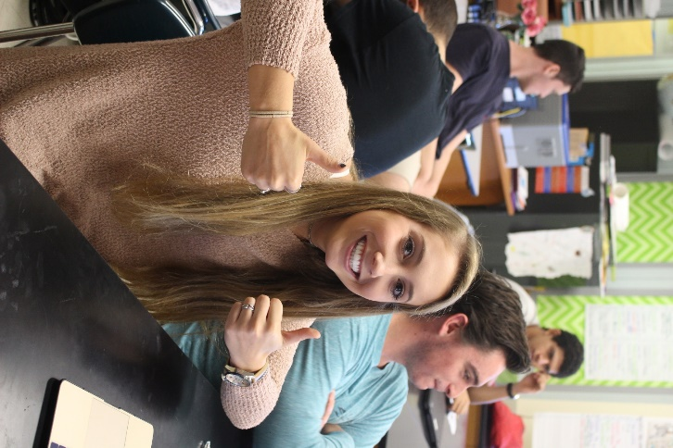
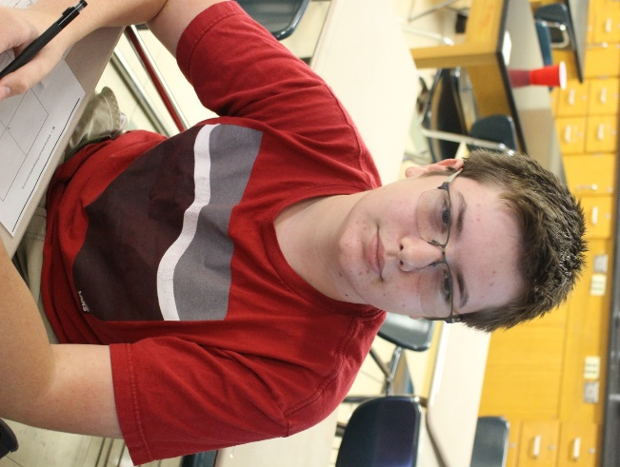
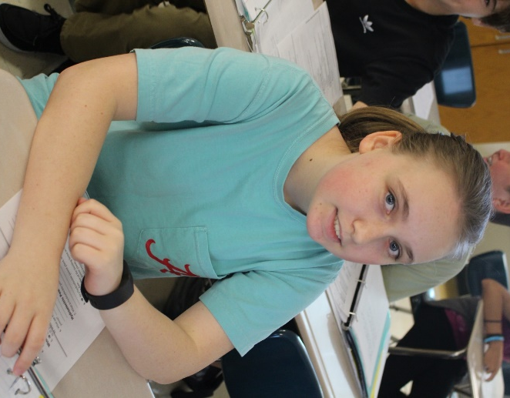
Mr. Poelma
1st Period Biology Honors:
Natalie Rader, Jesse Rego, Sheila Gonzalez
2nd Period Earth Space Science Honors:
Leo Snell, Elijah Blanco, Cora Cate Long
4th Period Earth Space Science Honors:
Gus Borski, Lilia Adrian, Alexandra Hardison
5th AP Biology:
Lily Costa, Sofia Gonzalez, Kailey Seiler
6th Biology Honors:
Grace Matthews, Maggie Duckworth, Alexis Martin

Slide 26
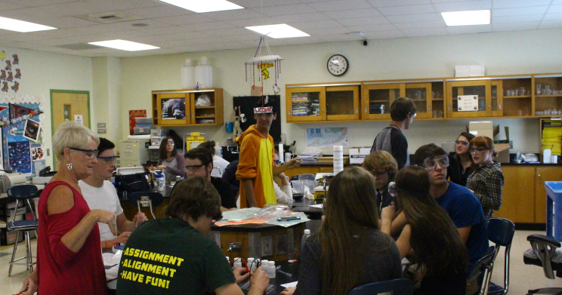
Ms. Rehmann
Honors Chemistry:
Anna Carucci
Rachel Medina
Dallas Christmas
Tristan Woolery
Katelyn McCollum
Chemistry I:
Brayan Rojas
Sergio Trujillo-Perez

Slide 27
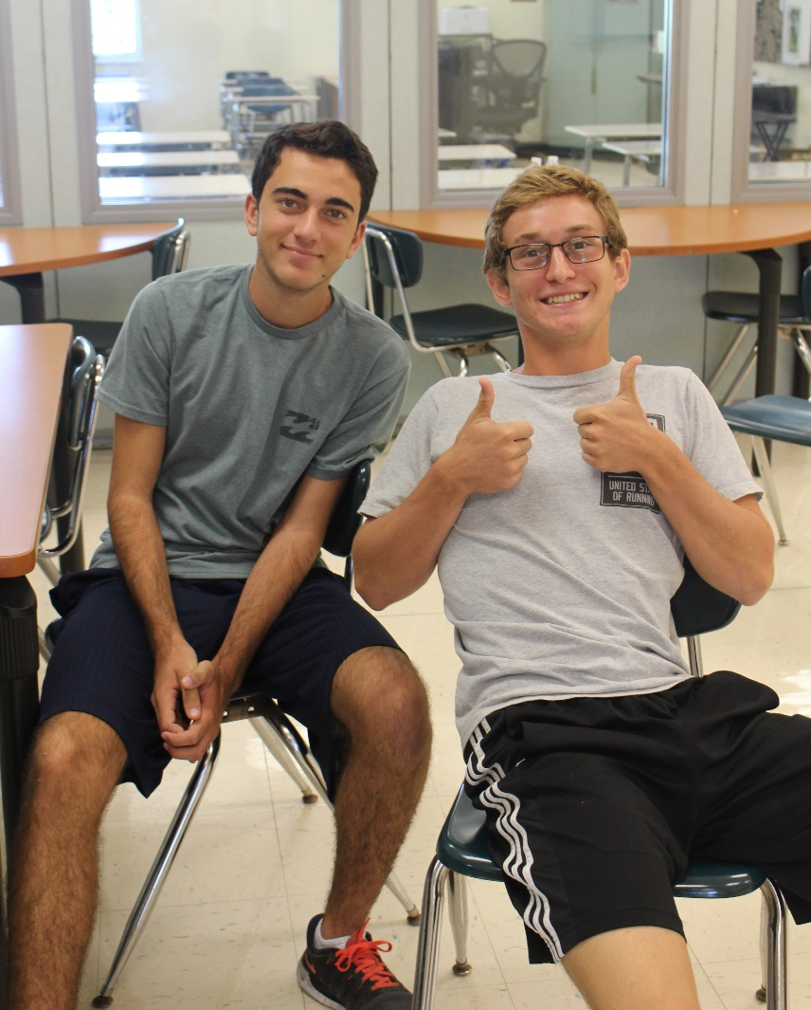
Ms. Rosenow
Leadership:
Emma Marsden
Alex De Toro
Marine 1 Honors:
Justin Ferrara
Bella Olsen
Marine 2 Honors: Paul Ross
Jacob Webb

Slide 28
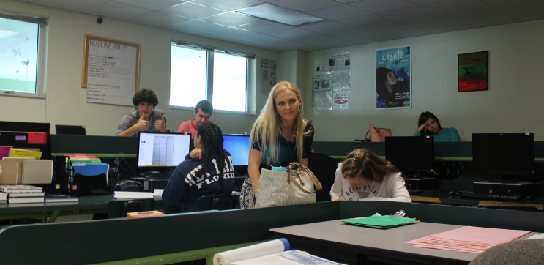
Ms. susa
100% in Ms. Susa’s English III Class:
Jordan Saylor
Tara Amador
Miguel Quezada
Ryan De La Torre
100% in Ms. Susa’s
Journalism Class:
Airiana Lindback

Slide 29
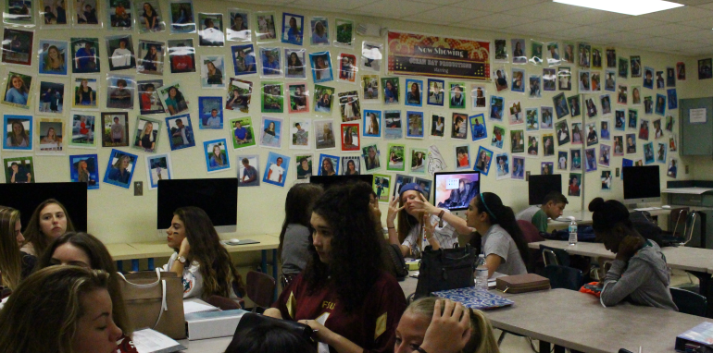
Ms. Thiery
Digital Production 1
Christine Aleman
Meliza Robert-Rodriguez
Sarah Duffy
Advanced DP
Hannah Lane
Gianna Ancheta
Roman Roberts
Ella Marsden
INTERN of the Quarter
AJ Leffler

Slide 30
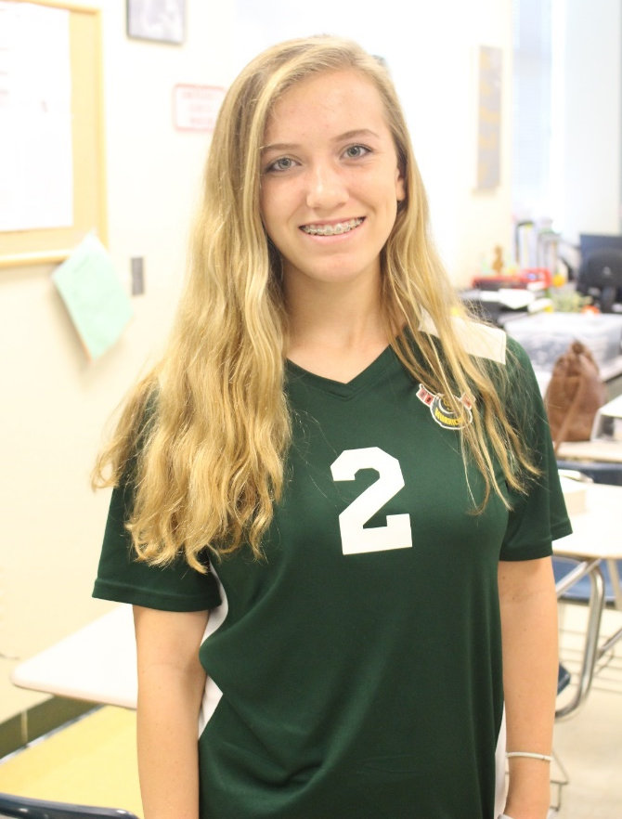
Ms. Truesdale
AP Macroeconomics:
Anna Carucci
Rebecca Galvan
Zach Roth
English IV:
Anthony Cosme
Aiden Hawkins

Slide 31
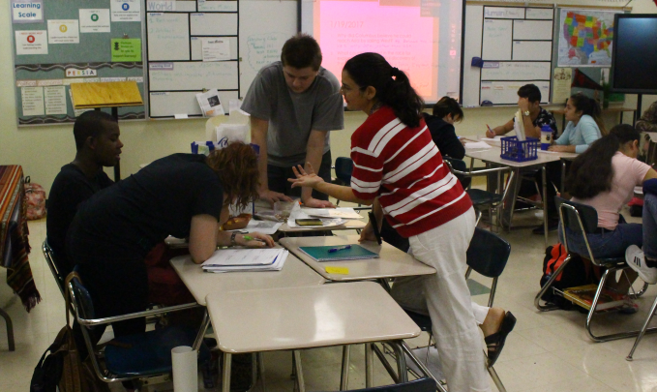
Ms. Welch
AP Human Geography:
Period 2: Sheila Gonzalez
Period 3: Ali Woltanski
Period 6: Emma Kost
Anthropology:
Period 4: Halley Lane
Period 5: Geovana Capitos
Period 7: Julianne Jankowski

Slide 32
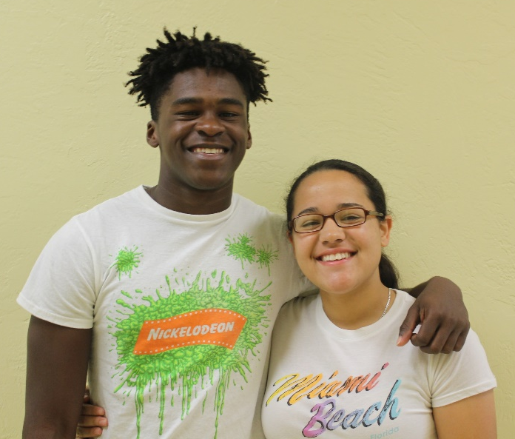
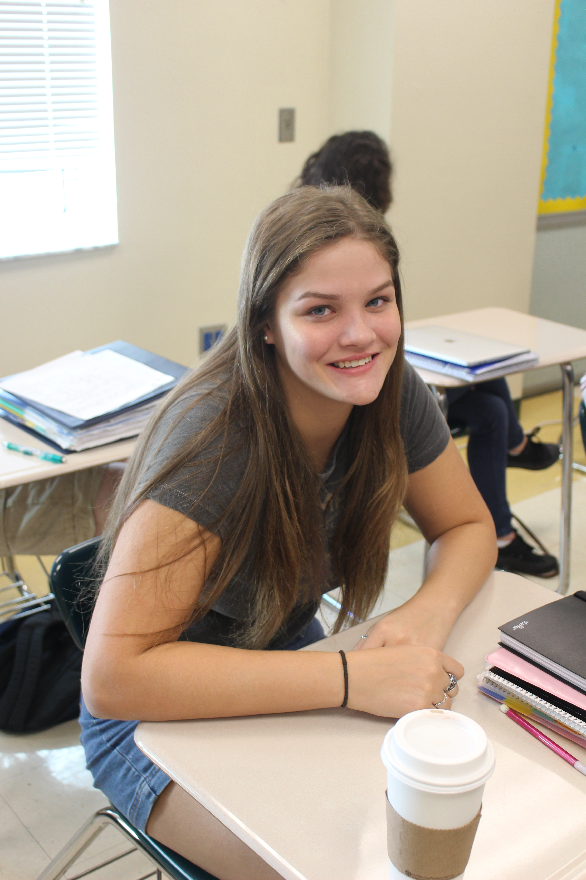
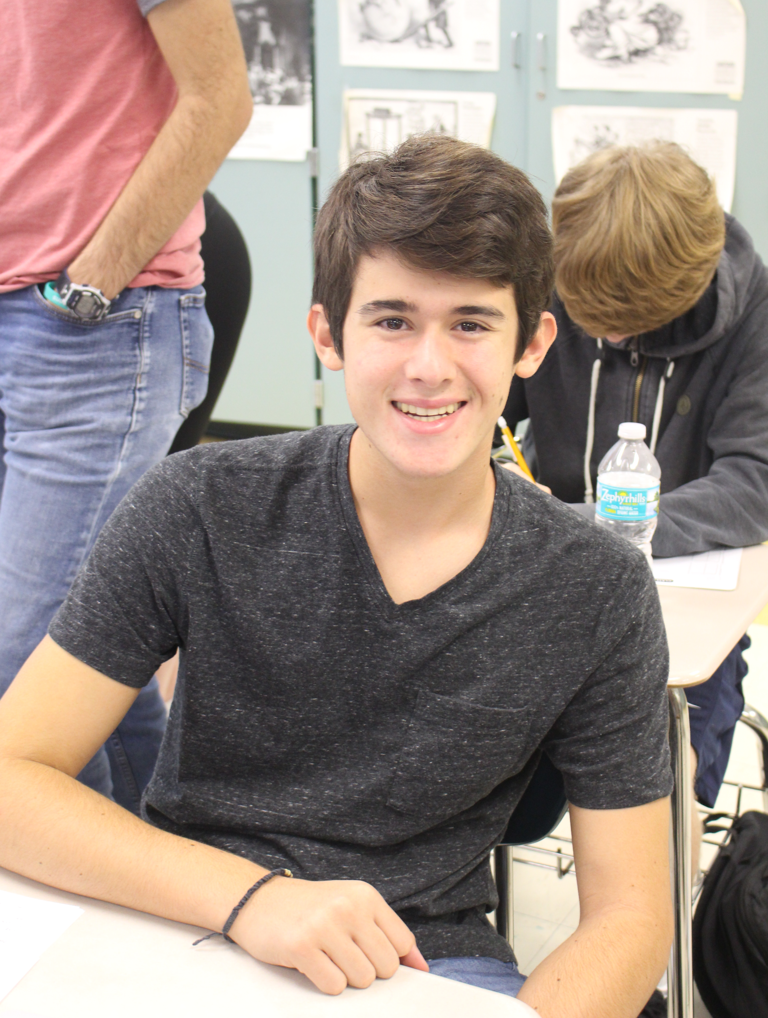
Ms. wischmeier
Geometry:
Simon Orjuela
Alondra Rodriguez-Diaz
Pre-Calculus:
Jeri Goldberg
Rachel Medina
AP Calculus:
Brooke Peacock
Jorgen Heilbron

Slide 33
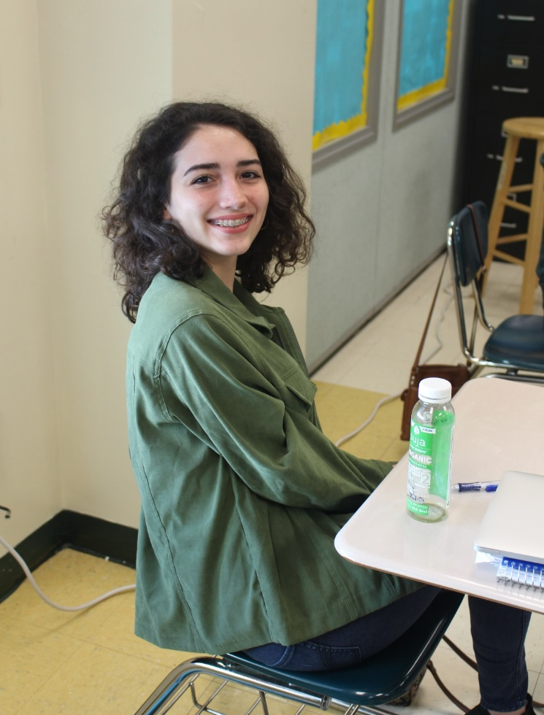
Ms. Zofchak
English 1:
Isabel Betancourt
Lorena Carballo
Caitlyn Casariego
Leekrystal Cruz
Miguel Gonzalez
Ashley Hilson
Kaylee Jensen
Quinn Johnson
Elise Jordan
Donavan Poe
Konnor Ross
Lauren Settoon
Liyiccia Torres
Cheyenne Veloso
Theater 1:
Tristan Woolery
Theater 2:
AJ Leffler
Theater 3 Honors:
Geo Capitos

Slide 34
1st Quarter Honor roll – 9th
Alexandria Adler
Christine Aleman
Isabel Betancourt
Krista Black
Elijah Blanco
Callie Bloom
Katharina Borders
August Borski
Alvin Brown
Colin Campbell
Lorena Carballo
Caitlyn Casariego
Liana Castagna
Clayton Conley
Lucas Dennis
Dominic DiMaggio
Clark Drebenstedt
Sarah Duffy
Yoendry Ferro
Katie Figueroa
Zakerie Filpes
Joseph Forcine
Andrea Galvan
Garret Gilbert
Miguel Gonzalez Gomez
Katelyn Gremonprez
Brandon Harrison
Donovan Hassen
Javier Hernandez
Ashley Hilson
Katie Holly
Dallas Hutchinson
Brianna Johnson
Quinn Johnson
Kaila Jorgensen
Jason Kaczka
Cody Kennedy
Michela Kidd
Jack Lindsey
Cora Long
Luis Maldonado
Zoe Marchetti

Slide 35
1st Quarter Honor roll – 9th
Alexis Martin
Angel Martin Santos
Kailee McDaniel
Regan McKenzie
Angelina Nappi
Breanna Perto
Patryk Pietruch
Donovan Poe
Skylar Poisson-Zettwoch
Noemi Quezada
Damaris Rego
Lucia Rodriguez
Olivia Rodriguez
Abigail Sebben
Lauren Settoon
Leo Snell
Kaylee Stoky
Maximus Stough
Brandon Turner
Jessica Vandergriff
James Warrington Hernandez
Jacquelyn Wiktorek

Slide 36
1st Quarter Honor roll – 10th
Taylor Albury
Mysty Anthony
Jean Baidet
Raffie Baker
Olivia Betancourt
Isabella Bolivar
Marlie Cakans
Brayan Calatayud
Martha Calix
Joshua Corliss
Melissa Diaz-Duran
Bridget Dougherty
Lily Firkins
Kanvis Frails
Lauren Fundyk
Amy Garcia
Irina Gonzalez
Jonah Gross
Luke Gutierrez
Susan Gutierrez
Lauren Hack
Windley Hagood
Jessie Head
Taegan Huntemann
Jena Jones
Susan Kendall
Carly Lindback
Max Lindsey
Ella Marsden
Brian Miller
Brittney Monteagudo
Caleb Montgomery
Imani Murphy
Steelman Nicoletti
Daniel Ornelas
Richard Owens
Joshua Prince
Bridget Rader
Jeronimo Reynoso-Heaton
Kevin Robles
Erin Rodberg
Mia Ruiz
Jennifer Setchell
Colton Snodgrass
Hannah Thomas
Zane Turbessi
Jade Tyler
Krystopher Velunza
Zachary Webb
Jonathan Williams
Chris Wong

Slide 37
1st Quarter Honor roll – 11th
Brayan Argueta
Jaime Aucamp
Charlton Augustus
Avery Caceres
Julianna Cano
Courtney Conley
Lily Costa
Ryan De La Torre
Cresaria Del Pino
Nicholas DiMaggio
Cara Erickson
Christian Ignacio
Leila Isidor
Shennan Kasprzak
Sarah Kelley
Anna Langley
Zybo Marchetti
Mabel Martinez-Benitez
Shannon McCormick
Genessa Miranda
Yaire Mollineda
William Mutz
Angela Ornelas
Yahely Ornelas
Timothy Orr
Ethan Osborne
Maria Otero
Hailey Pacyna
Michael Petrusha
Miguel Quezada
Valente Reynoso-Heaton
Katherine Robinson
Alondra Rodriguez-Diaz
Brayan Rojas Ramon
Sara Rubalcava-Mendoza
Draven Tucker
Morgan Whittle
Amber Wigle
Cassandra Willis
Kathleen Young

Slide 38
1st Quarter Honor roll – 12th
Caitlyn Abel
Zane Absten
Amanda Amador
Gianna Ancheta
Tyler Arnold
Victoria Aucamp
William Ayala-Gonzalez
Mason Baker
Cameron Barton Blanco
Brittany Beyer
Kyra Beyer
Josef Borski
William Coffin
Anthony Cosme
Jacob Curry
Ashley Day
Samantha Demeritt
Cody Dickerson
Andrew Dula
Andrew Fleites
Kathleen Foley
Sofia Garcia
George Guerra
Ryan Guth
Aiden Hawkins
Gina Hernandez
Savannah Hernandez
Samantha Howell
Julianne Jankowski
Sierra Jenkins
Alia Jones
Alex Jordan
Paige Joyce
Angelie Kelley
Jeffrey King
Kaj Klitgaard
Jay Kubida
Halley Lane
Richard Lindsay
Emma Marsden
Colt McGee
Daniel McMahon
Tyler Munchmeyer
Thomas Nelson
Adriana Ornelas
Jared Pastuck
Brooke Peacock
Lorena Perez
Bryan Placencia
Jason Polanco
Jakob Pooley
Melanie Porras
Alexis Rainwater
Connor Rhyne
Samantha Rodriguez
Paul Ross
Destiny Ruiz
Kailey Seiler
Nichole Thomas
Sergio Trujillo-Perez
Anna Wilson
Anna Wright

Slide 39
congratulations!

Slide 40
CREDITS
PowerPoint
Sophie WilliamS
Tyler Arnold
Jorgen Heilbron
Shennan Kasprzak
Photography
Sophie Williams, Lillie Carter, Barbara Mendez

